Slide 1
ME5412 Robotics for Healthcare
Group Project Briefing
MSc in Robotics
Cecilia Laschi
Department of Mechanical Engineering mpeclc@nus.edu.sg
Haoyong Yu
Department on Biomedical Engineering
bieyhy@nus.edu.sg

Slide 2
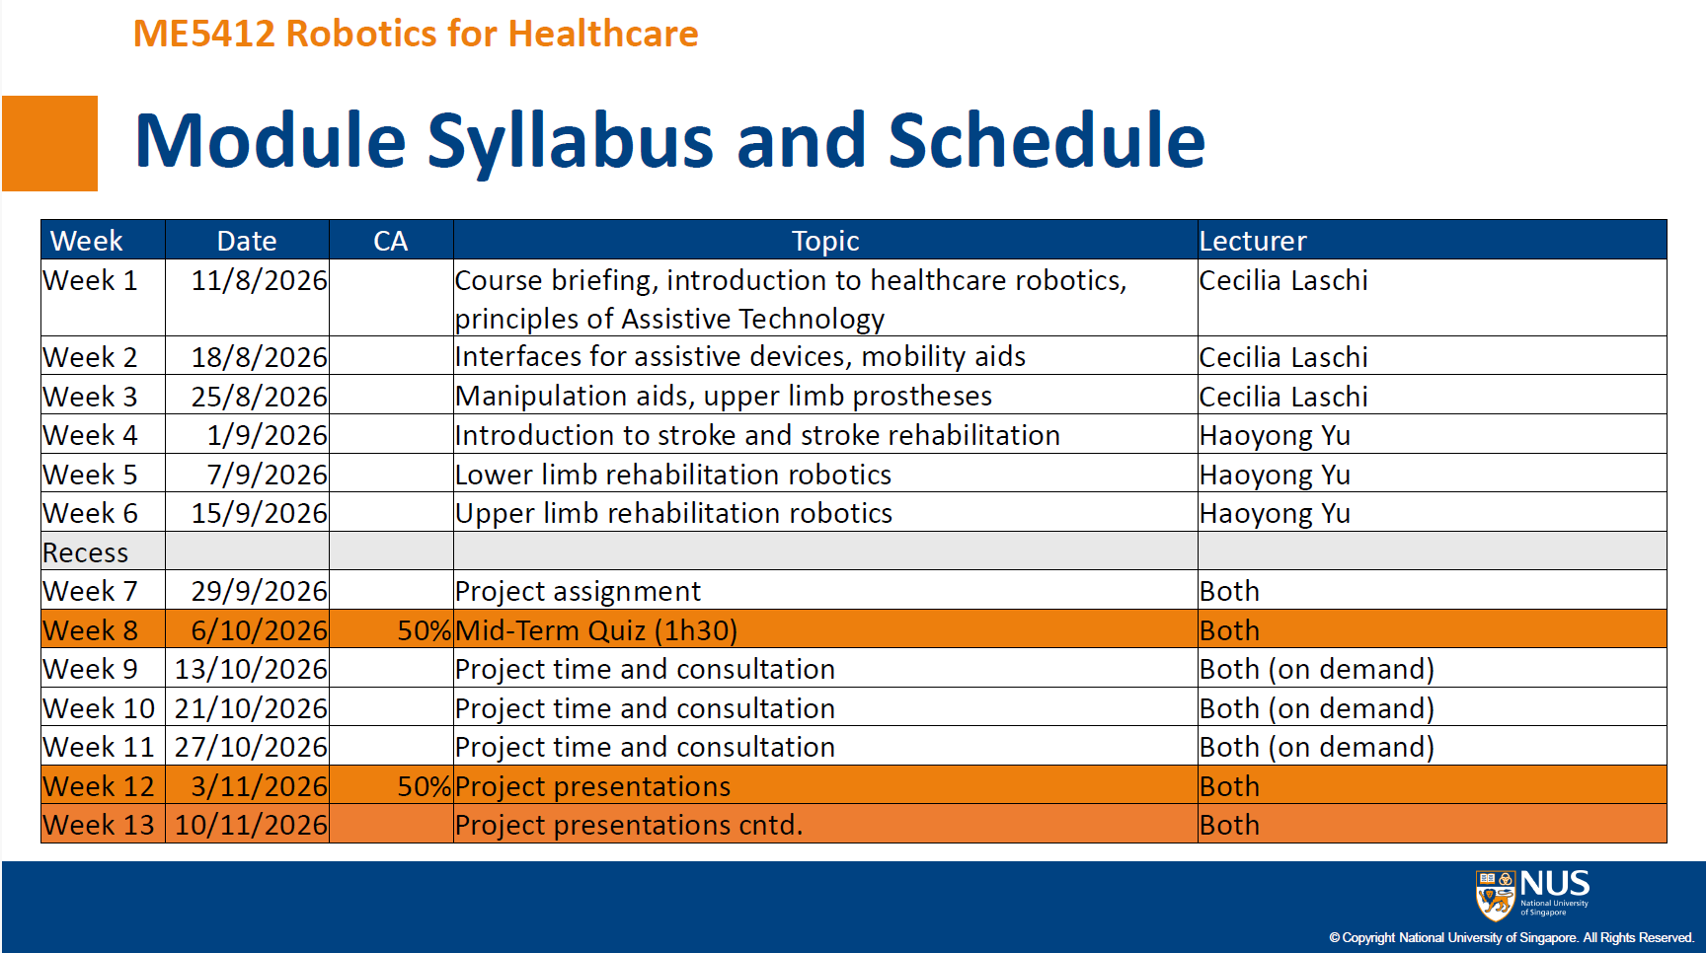

Slide 3
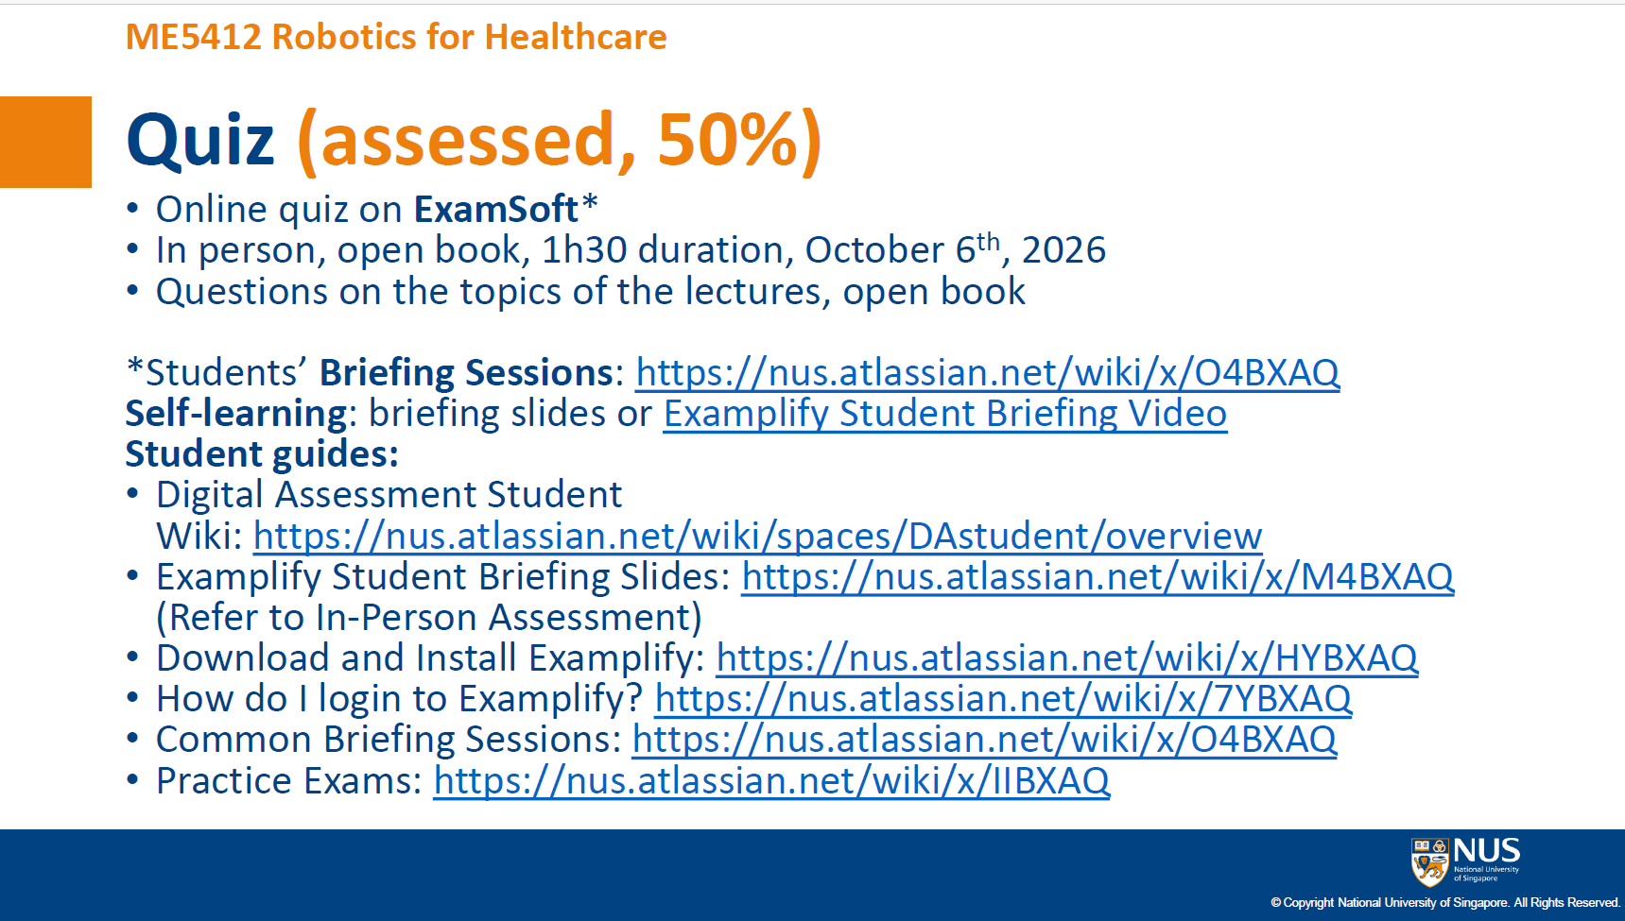

Slide 4
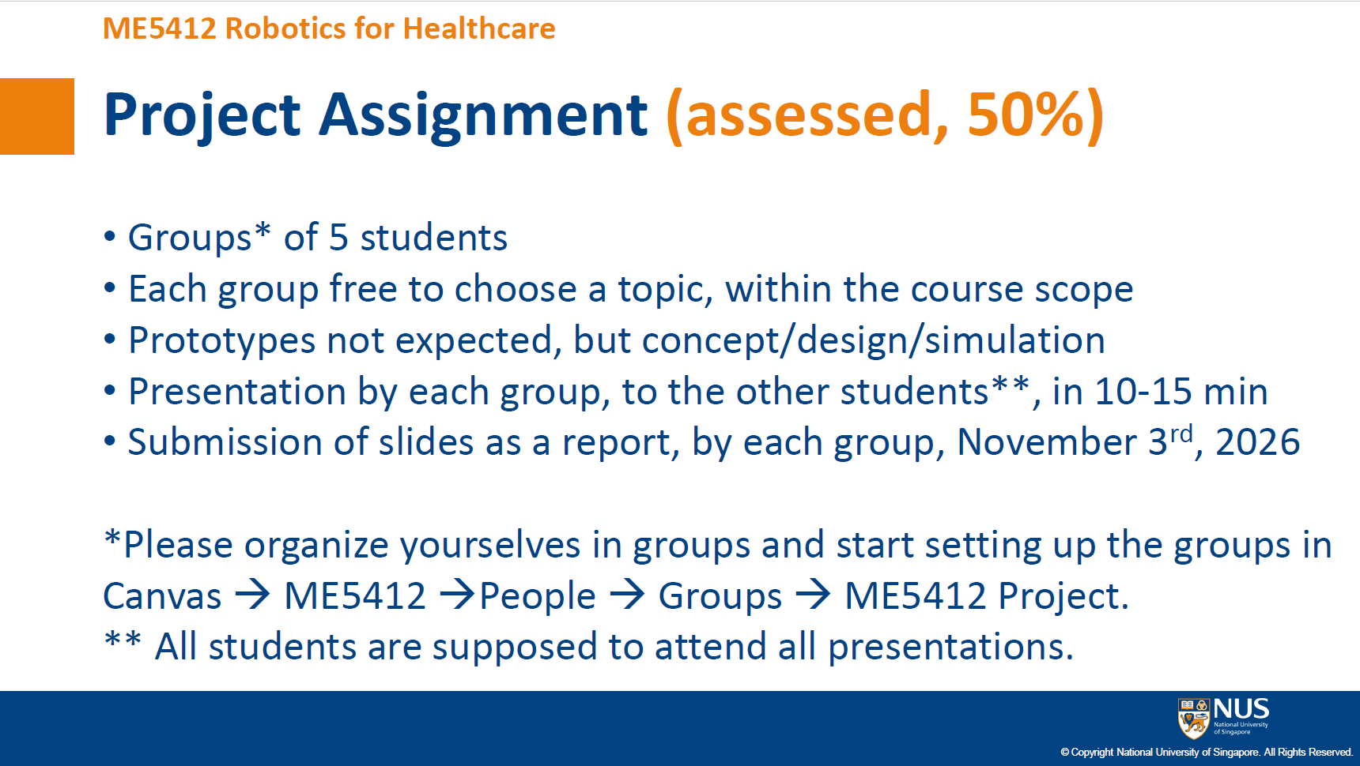

Slide 5
Project Groups Formed
19 Project Groups formed
5 students in each group, except group 4 with 6 students
Project 1 has 3 students: Chen Zekai, He Shiheng, Wanf Yuru
  Can Jonathan Lim Zhan Rui e0281337@u.nus.edu join this group?

Slide 6
Project Scopes
Robotics in Healthcare
  Assistive robots
  Rehab robots
  Prosthetics
  Robotics for healthcare workers
  Other healthcare related robotics systems
Assistive Technologies and devices
  Mobility aids
  ADL assistive devices
  Assistive devices for the elderly or people with disability
  Social robots
  Any assistive technologies to improve quality of life

Slide 7
Topics and Focuses
Be more specific on the healthcare problems to be solved
Be more specific on your innovations and solutions
  New systems or devices
  New approaches to solve an existing problem
    New Mechanical Structure
    New actuation
    New sensing
    New interface
    New control algorithm or software architecture (AI, high level, mid level, or low level)
  Avoid a broad and vague problem with a wish list of technologies without focus

Slide 8
Guideline on Presentations
10-15 minutes presentation and 5 minutes Q&A per group
  Problem statement
  Existing solutions and gaps
  Proposed solutions
    Diagrams
    CAD designs
    Simulations
    Videos
    Anoth forms of visualization
  Summary and discussion
    Close the loop!

Slide 9
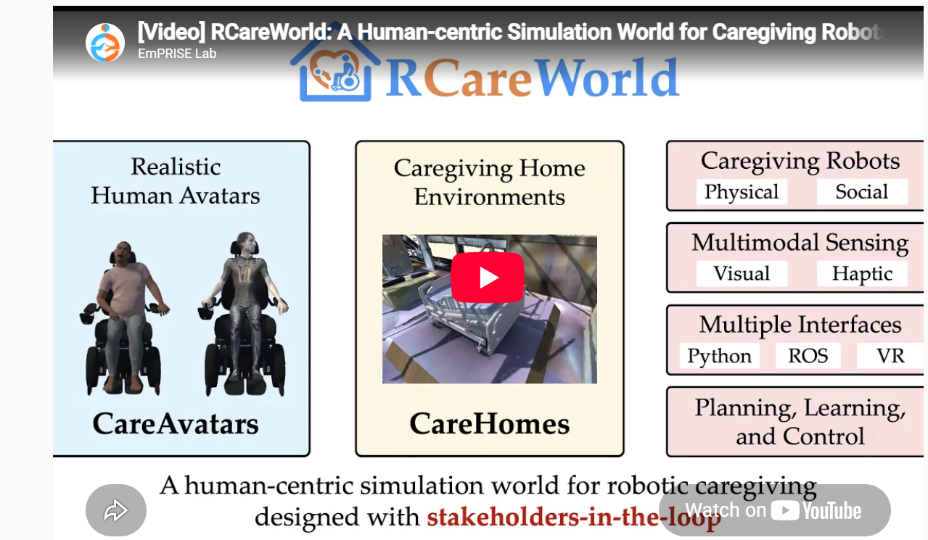
Simulator Example
RCareWorld: A Human-centric Simulation World for
Caregiving Robots
RCareWorld: A Human-centric Simulation World for Caregiving Robots – RCareWorld

